Slide 1

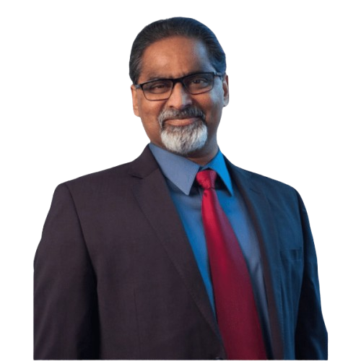
Gopi Shashti Poorti 60th birthday July 30th, 2025
Notes:
Welcome to Gopi’s Shasthipoorti. Shasthi is 60 and Poorthi means completion. This is a Sanskrit term.

Slide 2
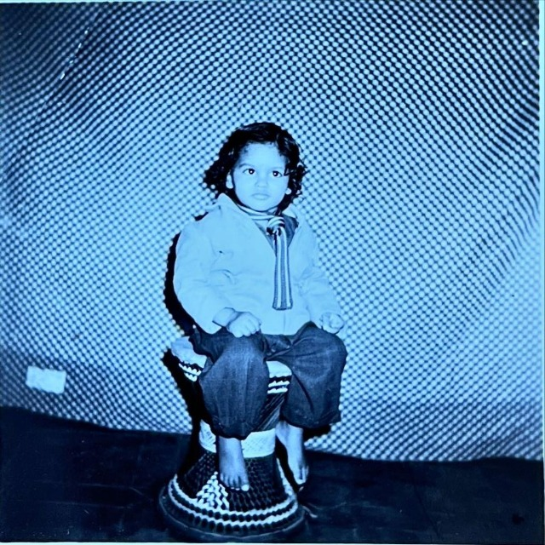
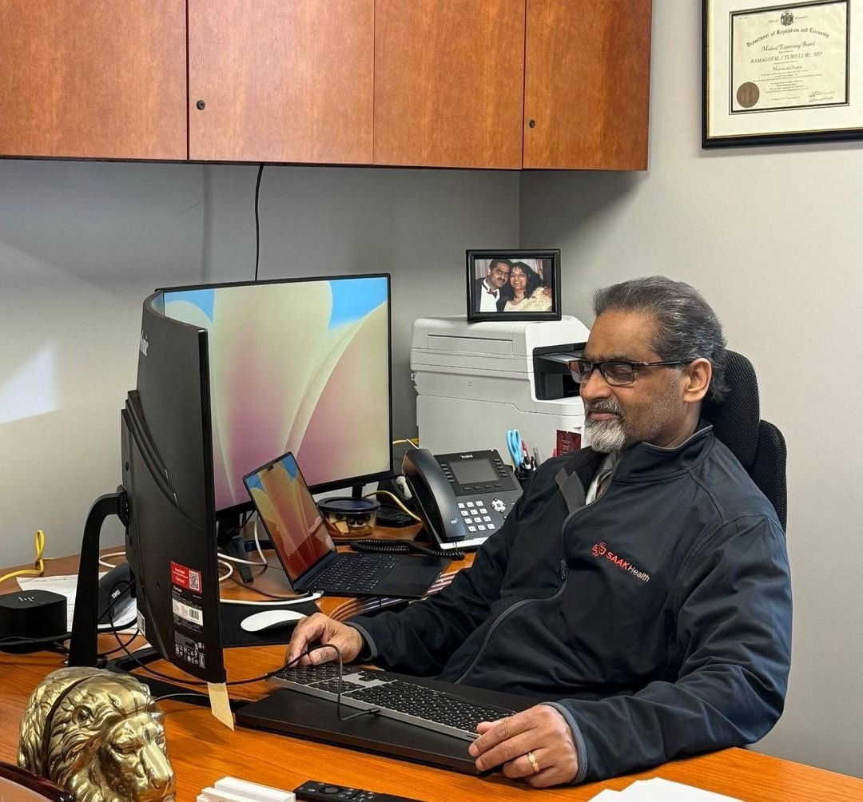
60 years
Notes:
Gopi as a baby to Gopi today as a founder of SAAK

Slide 3
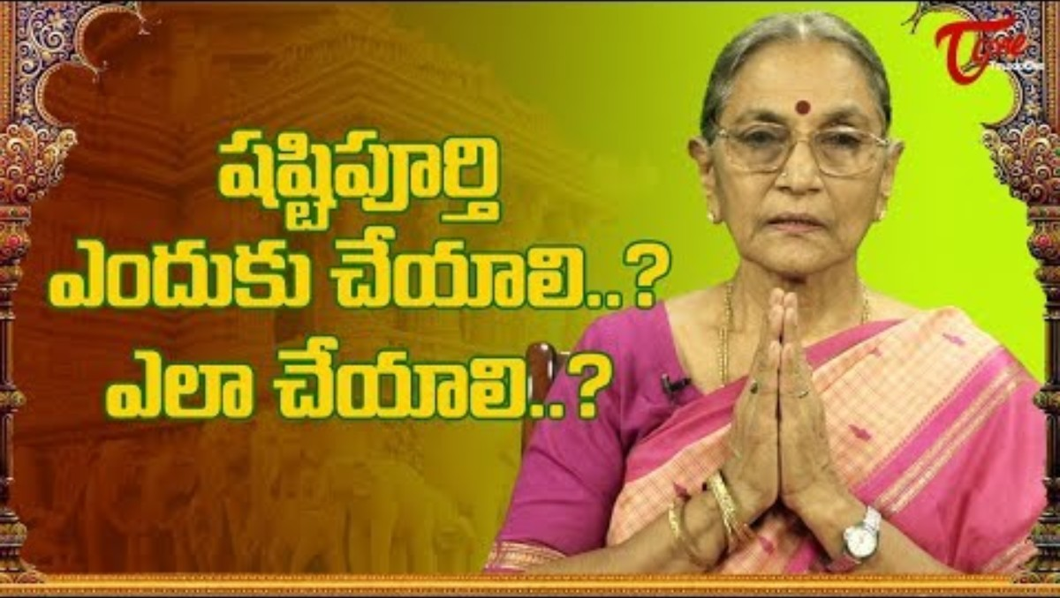
What does Shashti Poorti mean ?.

Slide 4
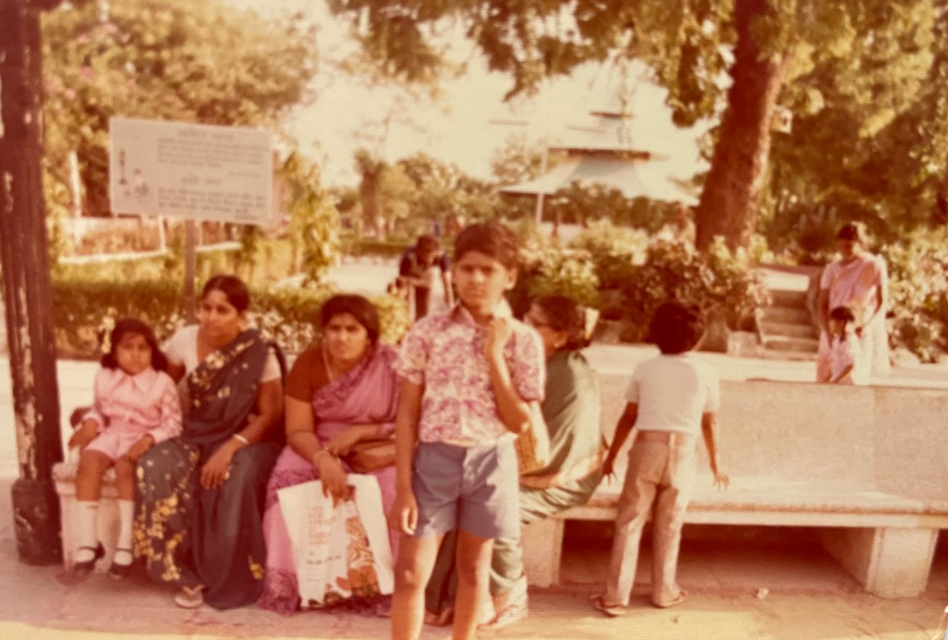
Life on his own terms (Hyderabad – 1972 )
Notes:
Gopi was never afraid to live his life on his own terms. During this phase in Hyd he would play with a stick and plants when alone and play with others on the swing, kabaddi, cricket etc.

Slide 5
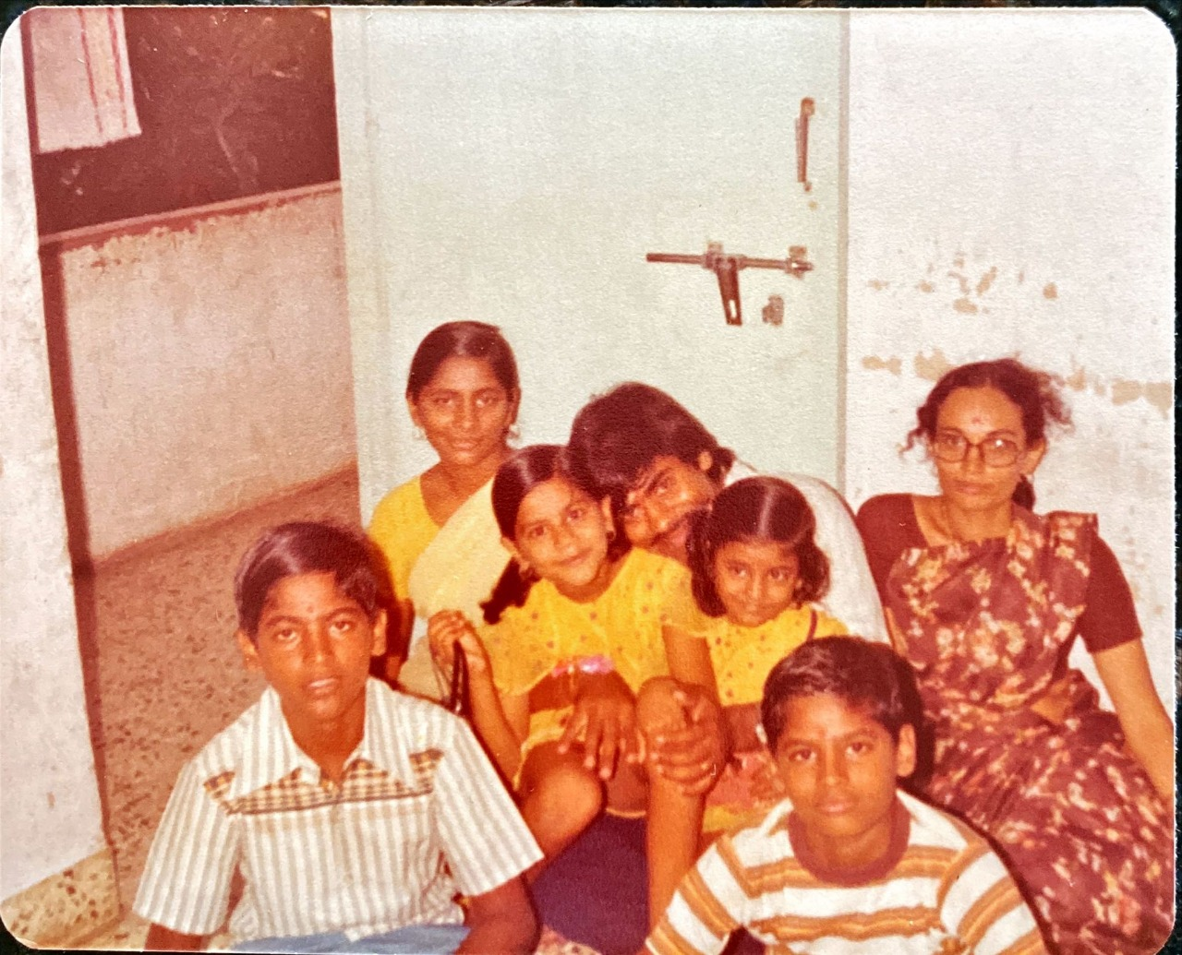
Life on his own terms – Ahmedabad 1977
Notes:
When my father got transferred to Ahmedabad our entire family was in a shock. We felt rudely taken away from the comfort of our life in Hyd. Gopi and I coped by playing “marbles” (goli) with local boys. We were terrified with the local bullies called Vagari’s and somehow managed to outwit them. Gopi studied in tents in this phase of school. He would get hand me down books which did’nt bother him and on occasion produced a book in two halves from his pockets which got the teachers in a puzzle.

Slide 6
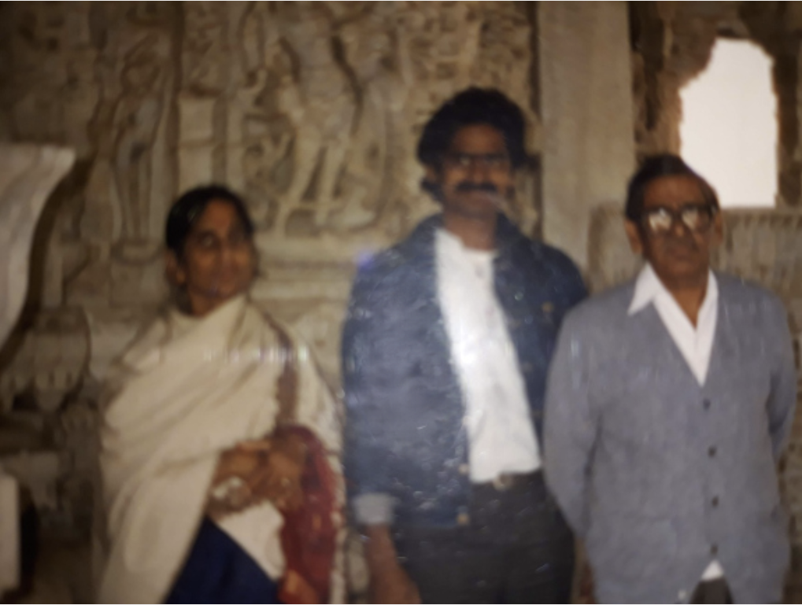
Life on his own terms – BJ Medical College – Ahmedabad 1980’s
Notes:
Gopi’s score during 12th suddenly jumped. He secured a state rank and got admitted to the prestigious BJ Medical college for MBBS. But he continued his cavalier ways. During the 1st year MBBS exam he burnt his hand badly with Diwali crackers but managed to pass his exam.

Slide 7

Life on his own terms – SAAK – Brookfield, Wisconsin 2024
Notes:
Today Gopi has chosen to climb another mountain. With Suman. He has successfully fought and won against monopolistic health-care providers. Demonstrating guts and initiative.

Slide 8
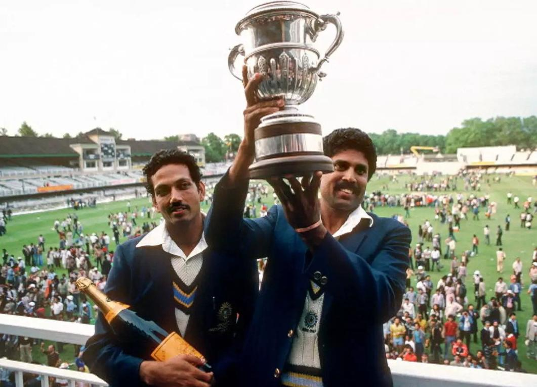
Large hearted – 1983 Cricket World Cup - Historic
Notes:
Gopi has always been large-hearted. One of the iconic moments of our college days was the 83 world cup in Cricket. It transformed us and Bharat. When I was about to leave for the US in 85, Gopi let me have the prized possession of a special edition of Sports-Star that featured the 83 world cup.

Slide 9
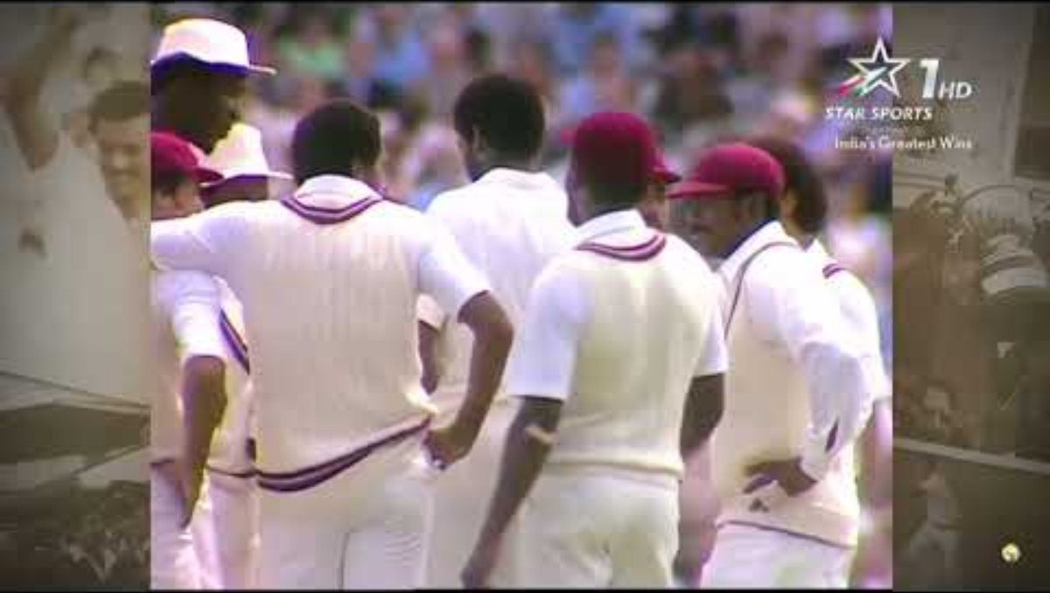
1983 Cricket World Cup – Finals -- Highlights

Slide 10

Chinmaya Mission – Sponsorship
Notes:
Gopi has donated to the Chinmaya mission in our father’s name. Lakshmi Akka knows more details.

Slide 11

Donation to Sanjivani hospital, Kuchipudi, AP, India
Notes:
Gopi and Suman have also donated generously to the Sanijavani hospital to put up a Cardiac unit. They also volunteered their time in service.

Slide 12
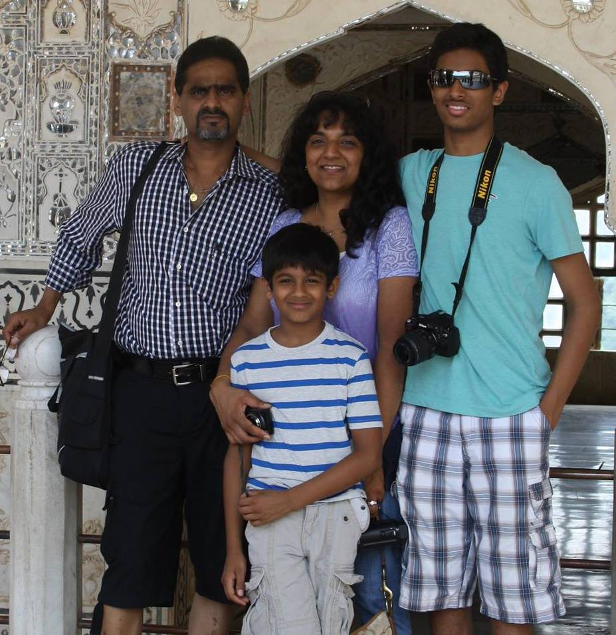
Family – Love, Nurture, Travel
Notes:
Family is 1st for Gopi. These are happy times touring. Probably Jaipur, India

Slide 13
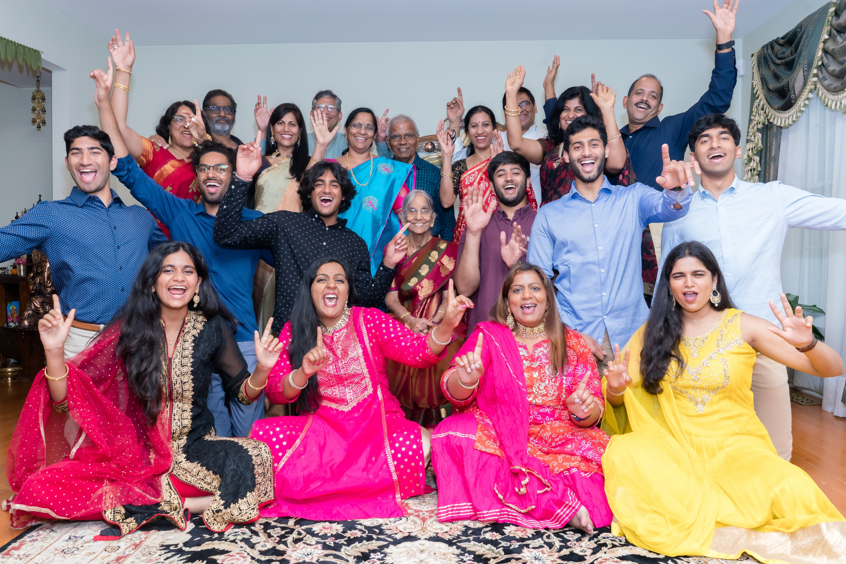
Extended Family – Commitment
Notes:
Gopi has all along been heavily committed to our Extended family as well. From routine work at home to special occasions such as Nitya / Divya’s wedding.

Slide 14
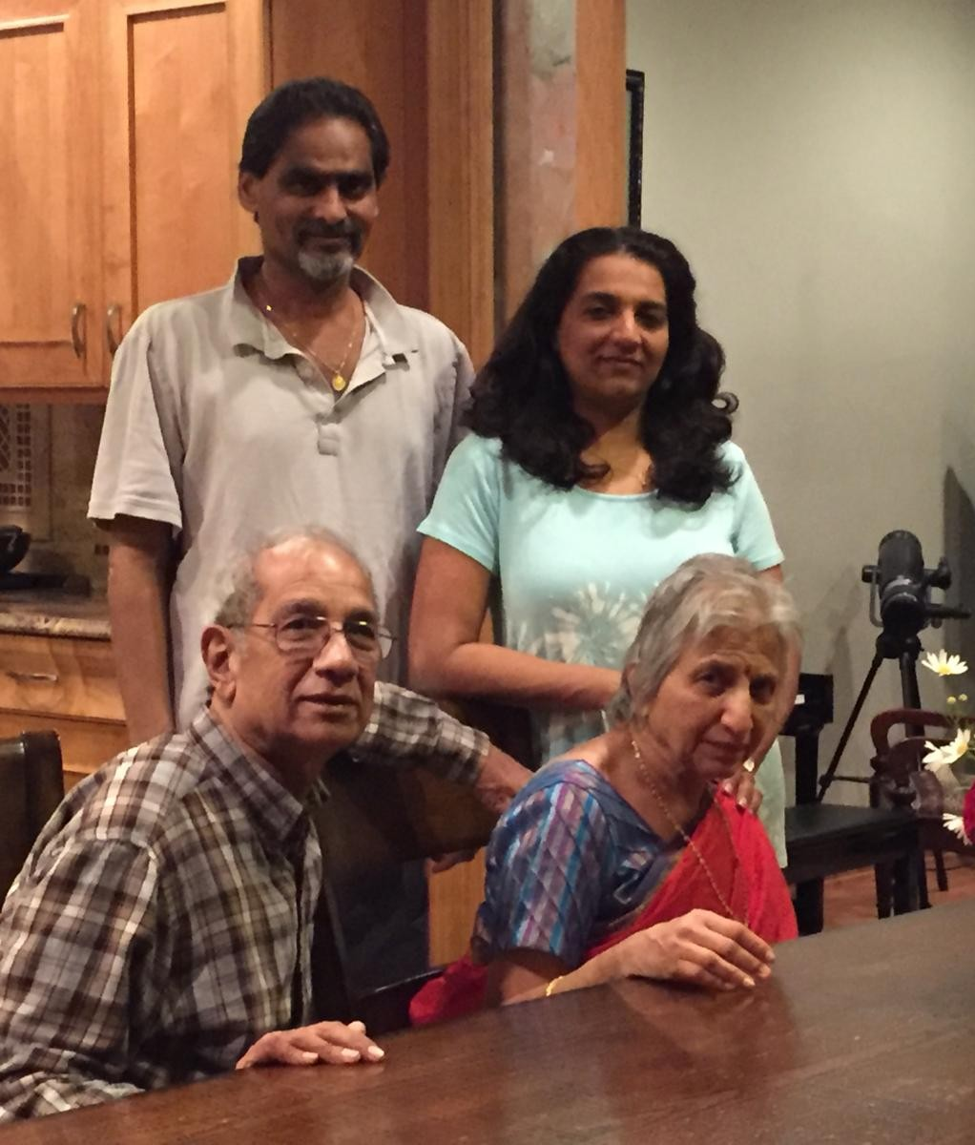
Extended Family – Commitment
Notes:
Gopi has all along been heavily committed to our Extended family as well. From routine work at home to special occasions such as Nitya / Divya’s wedding.

Slide 15
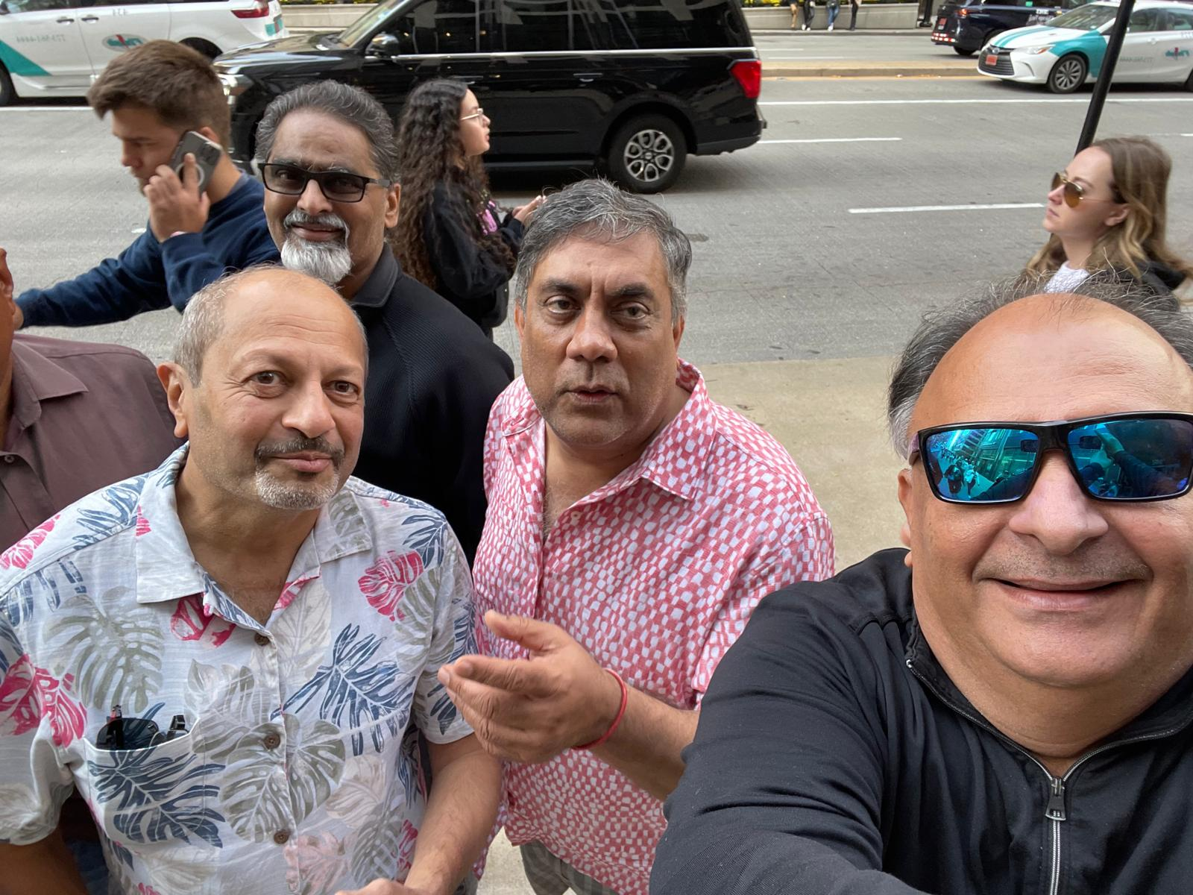
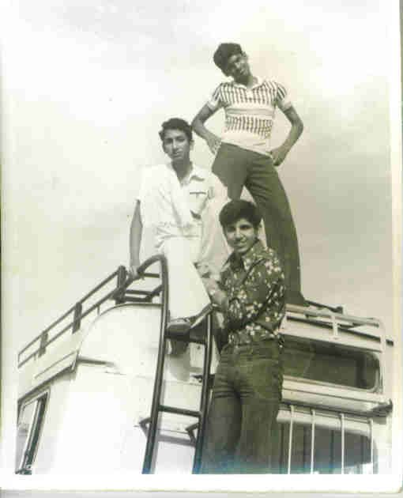
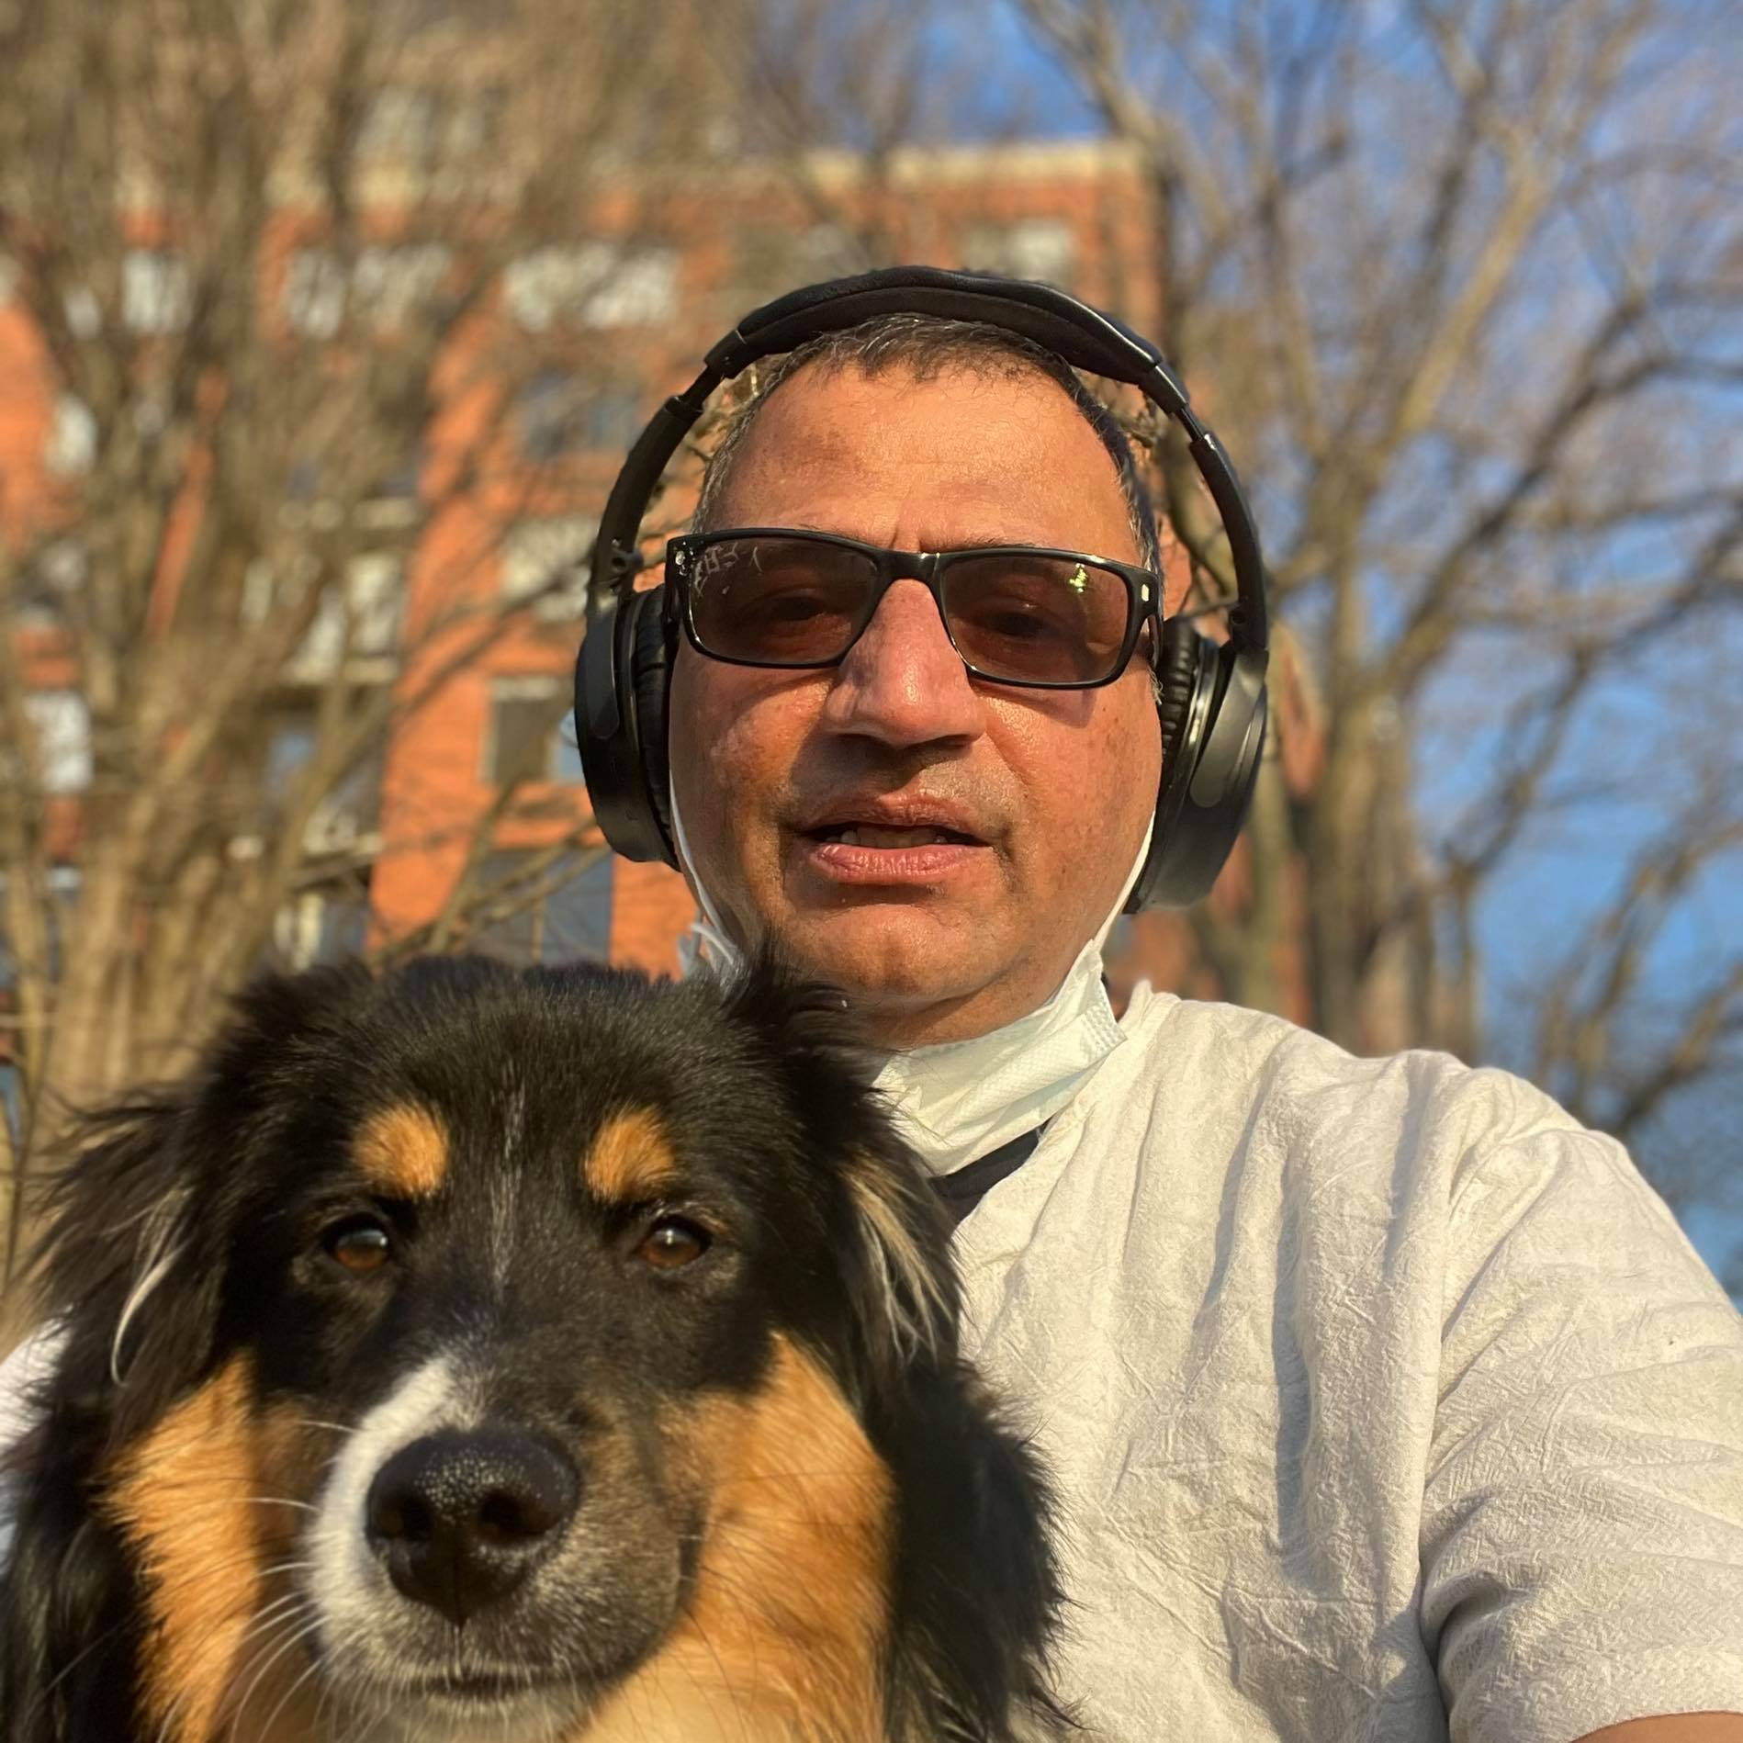
Friends – Masti, Camaraderie, Loyalty
Notes:
Gopi always maintained a healthy friend circle. This involved a lot of masti i.e fun, and plenty of loyalty as well. Gopi and his merry band helped out on many occasions. Especially during difficult times such as when our father passed away. They were the bedrock for the entire family. They were also involved in happy situations such as our marriage.

Slide 16
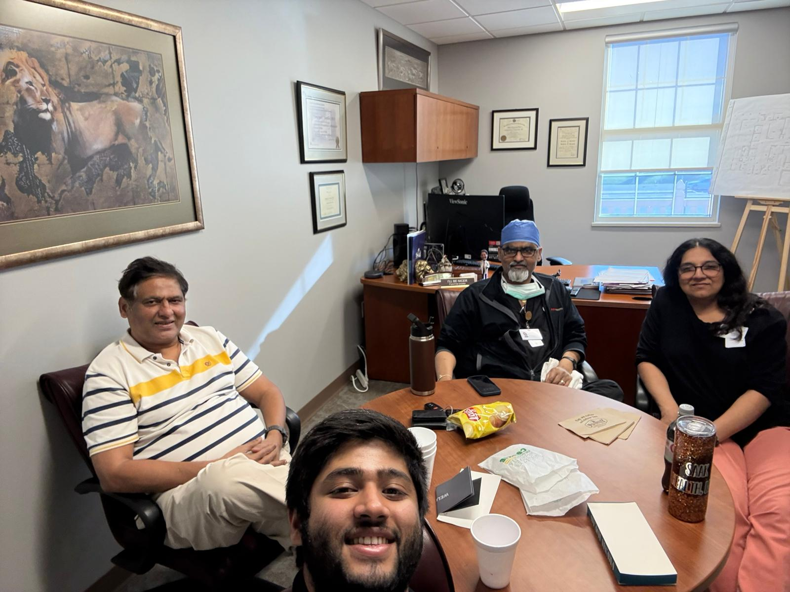
Guru -- Shishya
Notes:
Gopi & Suman mentored Chaitan to clear his USMLE – 1, Gopi got Chaitan a Fellowship. Gopi / Suman are helping Chaitan prepare for USMLE-2 and plan his upcoming wedding

Slide 17
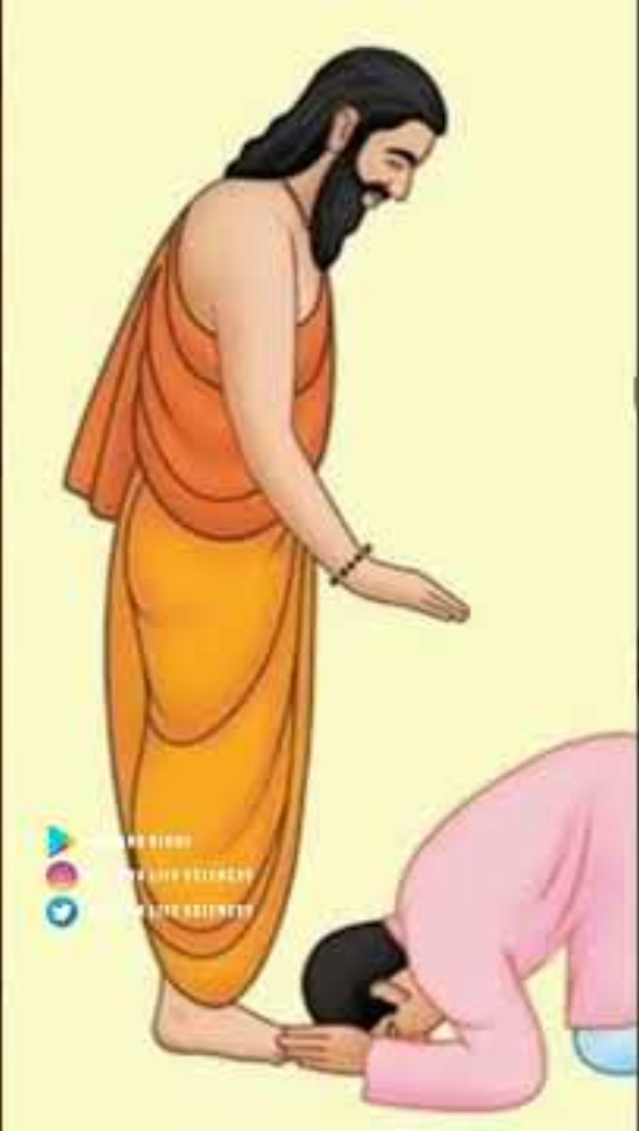
Shatamanam Bhavati – May you live 100 years
Notes:
Gopi – Shatamanam Bhavati … May you live 100 years

